Slide 1

Electronic Privacy & Security
Forum 2018-03-15
Copyright 2018 ©
Integrity Protection Service

Slide 2
The Majority of “Intrusions” are Low Tech
Humans are the leading vector for electronic intrusion, interception, data mining, keystroke logging, etc.
Well over 90% of the most widely touted cases of “hacking” were actually a result of the actions of a credentialed user’s actions.
Hardware and Software security measures are useful, but the single most effective protection against intrusion is guarding your actions.

Slide 3
Shield Your Personal Data
Create and alias
Wherever possible avoid providing your real Info

Slide 4
Your are Your First Line of Defense
Never offer information
  Forget the “win a free trip” “bingo cards”
Unless connected to a legal or financial transaction provide the info of an established alias
Never provide your cellphone number

Slide 5
Separate Your Phone Number from
Burnerapp.com subscriptions come with 1 or 3 auto-renewing lines, and unlimited calls/texts/pics.
1 Line Subscription Monthly - $4.99/mo
3 Line Subscription Monthly - $14.99/mo
1 Line Subscription Yearly - $47.99/yr ($3.99/mo) - 20% discount
3 Line Subscription Yearly - $139.99/yr ($11.67/mo) -

Slide 6
Guard Your Personal Information
You can protect yourself from manipulation, invasion of privacy, coercion, and humiliation by taking an aggressive approach to your use of technology.

Slide 7
Guard Your Personal Infomation
When creating your social media accounts DO NOT use unique identifiers of yourself, your spouse, children, etc.
That includes:
    Use your name, full or identifiable other
    Do Not use or include Place of Birth or Birthdate
    Do not indicate your hometown
    Do not indicate your workplace or job
    Your children
      Their schools, clubs, and teams

Slide 8
Guard Your Personal Information
Avoid placing stickers on your vehicle that specifically identify where you live, work, or frequent.
Don’t put your family on the rear window.
  Consider a creep saying, “oh she has 3 daughters and a cat, sounds like fun to me.”

Slide 9
Social Media
Do not announce that you are going away on a trip.
Do not post your birthday or your spouse, or children’s birthday
Avoid taking photos that would provide private details of your life or home.

Slide 10
Social Media
Do not post photos of yourself online
  Tell your friends and family to refrain from posting your photos online
  Monitor and delete any that appear without your knowledge (on friends and other sites)

Slide 11
Passwords
Do not make names or passwords aggregates of your:
  Name
  Dog, cat, bird, giraffe, etc.
  Important days:
    Birthdays
    Anniversaries

Slide 12
Social Media - Location
When posting to twitter do not include anything that would immediately identify you, your work, your location, etc.
  Post nothing that after 10 or 20 would through photographic comparison allow someone to triangulate your position.

Slide 13
Create an Alias (If at all possible)
Create a full profile that your can use everywhere. (Multiples would break up tracking)
  Create a name
  Fake birthdate
  Place of birth
  The rest of the data; elementary school, high school, etc.
Record it somewhere secure for reference
Use it all of the time

Slide 14
Your Biggest Threat
Your Home Network and Your Smartphone are

Slide 15
Stationary Network Easy Target
Your modem / gateway / router
Is on the internet 24/7
The ISP provides connectivity.
Although most people have dynamic IP service they rarely change.
Hackers and others have a fixed target.

Slide 16
Wi-Fi – Hotspots & Public Access
Your device grabs the network
Router provides an IP to your device
Your device accesses the internet
  It displays the ip address attached to the modem/router/gateway of the Wi-Fi router to which you are connected
  Add a VPN and you disappear

Slide 17
Wi-Fi – Is Sub-Standard
Wi-Fi is not equal to hardwired network
  The performance and security is always lesser
Wi-Fi – Is Insecure PERIOD !!
No matter what you do, Wi-Fi is insecure
No setting, not password will make it secure enough.
Wi-Fi with VPN is the only way to secure its data.

Slide 18
Wi-Fi Versus Hardwire
Wi-Fi 150 Mb/s (Megabit / Second)
  That is 150,000,000 bit/sec
  Yes, that is 150 million bits per second
Hardwire (Cat5e) 1 Gb/s
  That is 1,073,742,000 bit/sec
  Yes, that is 1.074 billion bits per second

Slide 19
Attacks Target the IOT (Internet of Things)
NordVPN cybersecurity’s predictions and trends for 2018 say that the IOT will be the main threat.
They warn that when one IOT “device is compromised, a hacker can easily overtake a whole system of interconnected devices”.
US Cert (US Computer Emergency Readiness Team) explains - Why Should We Care?
Cars, appliances, wearables, lighting, healthcare, and home security all contain sensing devices that can talk to other machines and trigger additional actions. Examples include devices that direct your car to an open spot in a parking lot; mechanisms that control energy use in your home; control systems that deliver water and power to your workplace; and other tools that track your eating, sleeping, and exercise habits.

Slide 20
IOT Cloud Leaks Your Data Like a Sieve
IOT technology provides a level of convenience to our lives, but it requires that we share more information than ever.
The security of this information, and the security of these devices, is not always guaranteed. It is common that the providers / cloud intermediaries mine your data and sell it freely.

Slide 21
Government Intrusion and Bad Actors
The court has ruled in hundreds of cases that the government has the right to have providers of data services, including OnStar and similar services to reroute the audio and any other data, i.e. GPS, directly to the agency without your knowledge. The same and worse occurs every day through exploiting Amazon Alexa, Google Home, Apple’s Siri, and more. You have provided the means, paid for the equipment, all they or hackers need to do is turn it on. Is the Star Trek voice command “coolness” worth forfeiting your privacy and the sanctity of your home?

Slide 22
Cellphone Anonymity
Shield your Identity from
the world

Slide 23
Protecting Your Cellphone Number
You can simply limit the exposure of your cellphone number to the outside world with extreme prejudice.
OR
You can use a third party service to create one or multiple phone numbers. You can use multiples on the same phone. The service provides text, voice, and images.
If you have friends or families who are dating on the internet, dealing with difficult or unstable friends or family members, then they need to use a masking service.
You can “kill the number” once each month insulating you.

Slide 24
Addon / Burner
You can simply limit the exposure of your cellphone number to the outside world with extreme prejudice.
OR
You can use a third party service to create one or multiple phone numbers. You can use multiples on the same phone. The service provides text, voice, and images.
If you have friends or families who are dating on the internet, dealing with difficult or unstable friends or family members, then they need to use a masking service.
You can “kill the number” once each month insulating you.

Slide 25
Network Topography
Hardware and software
Layout of the Network

Slide 26
Network Hardware
Physical Layer
  Modems / Gateways / Routers
  Wi-Fi vs Hardwire
  Multiple Routers
    Creating secure separate Network subnets
  Hardware VPN

Slide 27
Network Software
Anti-Malware
Anti-Spam
Anti-Virus
Firewall software

Slide 28
VPN – (Virtual Private Network)
The only way that we may maintain a modicum of privacy for our network traffic is to employ a Virtual Private Network (VPN).
A VPN establishes a virtual pipe, shield, around your data packets as they leave your network to traverse the internet.

Slide 29
VPN - Hardware
VPN – Virtual Private Network
  End to End Point VPN Hardware
  Dedicated Device
    All functions of the VPN occur within the device
    Device actually sits between the outside WAN (Wide Area Network) and the Intranet (Inside)

Slide 30
VPN – Virtual Private Network
A VPN creates a pipe between your device or Network Router and the other end of the VPN. The far end is typically a server or another router which then links the two together protected from sight, surveillance, or intrusion during the data transit.

Slide 31
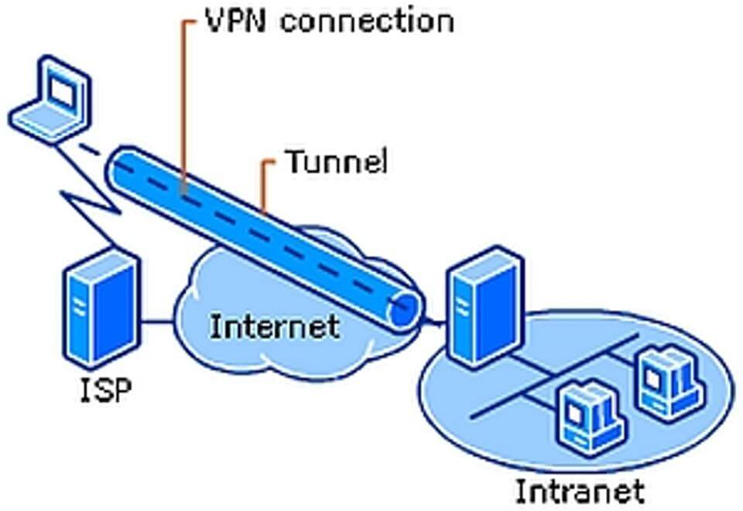

Slide 32
VPN – Hides Your IP Address
The moment that you log onto the internet your computer begins transmitting your IP address.
Your ISP logs and maintains a record of where you go, how long you stay, and what you up and download.

Slide 33
VPN – Your Data Traffic is Shielded
You can log onto a public Wi-Fi hotspot without worry. The VPN encases your data, everything in your internet traffic in the VPN pipe.

Slide 34
VPN – Everyone Needs a VPN
A simple, fast, reliable, and effective VPN is NordVPN
( nordvpn.com )
It has a no log policy, provides Tor over VPN, has an Automatic Kill Switch, Provides unlimited throughput, double data encryption, and unrestricted internet.

Slide 35
VPN – Seamless Use After Setup
After the initial installation and configuration, you use the internet as usual.
The VPN encases your traffic between your system and the VPN server.
The traffic then goes out on the internet and back in kind.

Slide 36
Devices at Threat
Common points of intrusion

Slide 37
Computer & Key Network Devices
Desktop Computers
Laptops
Tablets
Routers
Wi-Fi Routers, Extenders, Bridges
High Speed Internet Modems

Slide 38
Communication Devices
Cellular Telephones
  Burner Phones
  Used Phones
  Smart Watches
Wireless and Internet Intercoms

Slide 39
Network Backbone Devices
Cable Modem
Gateways
Routers
Wi-Fi
  Wi-Fi Extenders
  Access Points

Slide 40
Multimedia Devices
Smart TV’s
Roku
Amazon Fire
Google Chromecast
Apple TV
Android Third Party TV Devices

Slide 41
Connected (Eavesdropping) Devices
Alexa
Google Home
Apple Homepod

Slide 42
Personal Monitoring (Tracking) Devices
Fitbit (Fitness Monitors)
RFID Tracker
Child Tracker
GPS Tracker

Slide 43
Surveillance Devices
Ring Doorbells (or similar)
Wireless CCTV Cameras
Wireless Baby Room Monitors

Slide 44
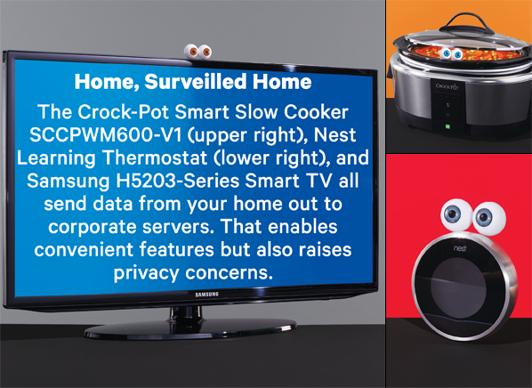

Slide 45
IOT Devices (Internet of Things)
Washing Machines
Clothes Dryers
Refrigerators
Coffee Makers
Robot Vacuum Cleaners
  They map the interior of your home

Slide 46
Vehicle Electronics Devices
On-Star, eCall, MyLink, Lexus Link, Dashtop Mobile, MVEDR
Advanced Automatic Collision Notification
GPS tracking unit
LoJack

Slide 47
Home Monitoring Devices
Electric Usage
Thermostat (Heat/AC)
Water Usage

Slide 48
TED® - The Energy Detective
Comprehensive and user-friendly, The Energy Detective (TED) delivers an all-in-one sophisticated solution to help you track your electricity usage from anywhere, in real-time. TED operates in multiple functions as an in-home monitor for all of your energy outlets to help you perform your own home energy audit on voltage and power expenditures.

Slide 49
User Friendly = Wide Open & Easy to Hack
Humans are lazy.
They want simple and tech free
Tech was slow to be adopted until they made computers like toasters and handheld computers into telephones

Slide 50
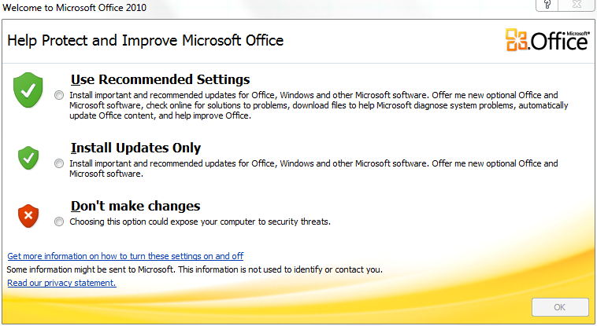
Beware the “Recommended Install”

Slide 51
The Threat That You Know
Most IOT devices are touted as “user friendly”. The term user friendly should normally be interpreted as low security and on the “cloud.”
User agreements allow the primary purveyor to “share” your personal usage patterns, data, user names, passwords, and much more for a price.
Let’s explore how the cloud works.

Slide 52

The Cloud is a Honey Pot

Slide 53

The Cloud is a Honey Pot
Network security specialists use the term Honey Pot to describe a large amount of data stored in a single location.
Amazon Cloud Services, Apple iCloud, or Google Cloud aggregate unfathomable amounts of data from millions of sources and store them on a single sever farm.

Slide 54
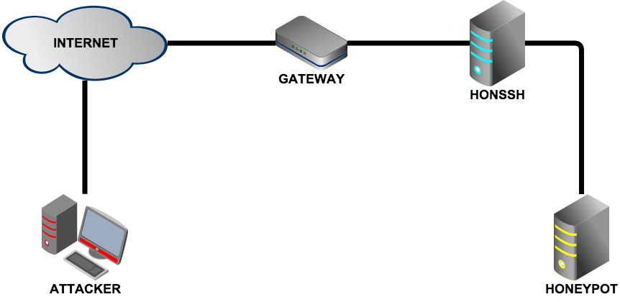
The Network (Cloud) Honey Pot

Slide 55
The Cloud – Smart TVs How They Work
Almost all smart TVs have built-in functions that identify what you are watching and from what source.
The TV creates dataset (like a fingerprint) of that content and sends it to the cloud storage of the Smart TV manufacturer.
The TV cloud provider processes the data, stores it, associates it to you (generally to your cellphone).
The provider creates a list of personalized offerings of similar content and displays it seamlessly on your Smart TV.

Slide 56
Voice Control – Across All Devices
Smart TVs, Cable TV Converters, Set Top Boxes, Cellphones, and more have Voice Control functions.
All of those systems utilize the cloud to handle the process.
Devices from Bluetooth speakers, to Digital Personal Assistants, Refrigerators, and endless list of other devices now offer digital voice recognition and recording.
They all utilize Amazon, Apple, and Google

Slide 57
The Cloud – Voice Control How It Works
Voice Recognition is extremely complex and requires a lot of computing power
The devices record your voice and sends it to the cloud of the respective voice recognition engine.
The voice recognition engine provider processes the data, stores it for between 72 hours and permanently, associates it to you (generally to your cellphone).
The voice recognition engine provider responds to your device with a data command associated to your voice command.

Slide 58
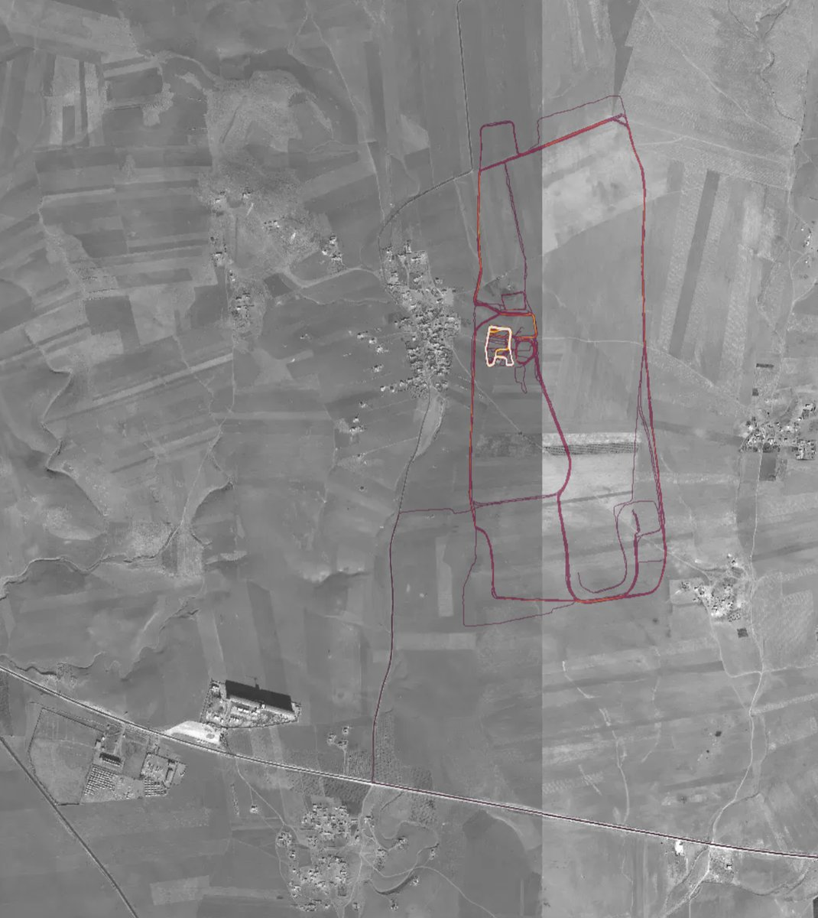
A Case Study – The Butterfly Effect
Fitbit
  November 2017 - Strava, an exercise-tracking firm, released their global heatmap. It was built using data captured from Fitbits connected to their mobile app. 13 trillion GPS points from their users (turning off data sharing is an option). It looks very pretty, but not amazing for Op-Sec. US Bases are clearly identifiable and mappable.

Slide 59

The Law of Unintended Consequences
Why does it matter if someone knows:
Where you jog?
The time?
How often?
Maybe you are single woman alone in the city. Maybe you are an attorney or psychologist with an unstable client.

Slide 60

Your Data Can Threaten Your Life
The Fitbit / Strava app data not only mapped top secret US military bases, Allied bases, but exposed personal data about activity patterns of high security convoys, bunkers, and many other areas.
The release of data threaten the national security of the USA, its soldiers, and others.

Slide 61
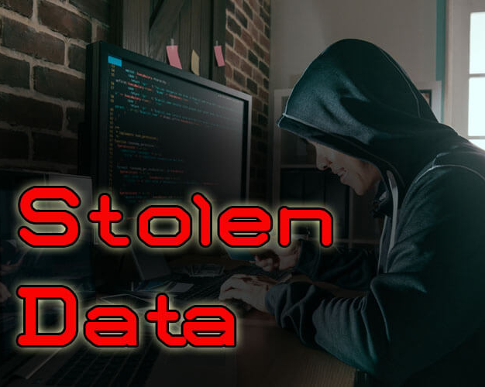
Your Data is Sold 1000’s of times on the Web
The Dark Web is an open anonymous marketplace teaming with your data and an endless stream of government, corporate, and criminal consumers.

Slide 63
The Three “Fronts” in the War on
Your Privacy & Electronic Records
Medical
Financial
Ancillary

Slide 64
X
Many hackers are bored, techies, looking for an intellectual challenge. They are often anti-social looking to be recognized for once. Many even consider being arrested for it as a career move. The list of hackers who make million + dollar incomes after their release is shocking. Google, Apple, HP, and many more hire them to “load test” their devices and software to help avoid public relations disasters.

Slide 65
Actual Hacks – Almost All Use Kiddie Scripts
The first hacks of a new product require high level programming and electronics skills. After the first few successful hacks, the hackers “share” there success with the world.
What does that mean to you?
Now a 10 year old in his bedroom can hijack your Z-Wave door lock and open it for his friends to break in when you leave for work. They walk right in your front door.

Slide 66
Hackers Are a Double Edged Sword
Many hackers are bored, techies, looking for an intellectual challenge. They are often anti-social looking to be recognized for once. Many even consider being arrested for it as a career move. The list of hackers who make million + dollar incomes after their release is shocking. Google, Apple, HP, and many more hire them to “load test” their devices and software to help avoid public relations disasters.

Slide 67
Hackers Are a Double Edged Sword
Many hackers are bored, techies, looking for an intellectual challenge. They are often anti-social looking to be recognized for once. Many even consider being arrested for it as a career move. The list of hackers who make million + dollar incomes after their release is shocking. Google, Apple, HP, and many more hire them to “load test” their devices and software to help avoid public relations disasters.

Slide 68
Ancillary Records
Clubs
Discount Cards Programs
Mobile Devices
  Apps (in general)
  Contact Data
  Financial Data
  Sensitive Personal Materials
    Photos
    Personal Information
Social Media

